Slide 1
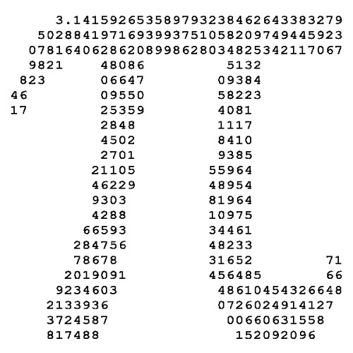
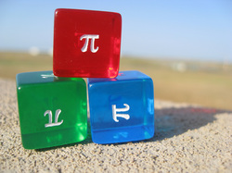
Изследователският подход в математическото образование в Македония - придобиват ли учениците квалитетни и постояни знания
Анета Гацовска - Барандовска
Универзитет „Св. Кирил и Методиј“,
Природно – математички факултет, Институт за математика, Скопје
„Национален семинар по математическо образование - Изследователският подход в математическото образование
София, 29-30.11.2019

Slide 2
Abstract
The Macedonian educational system is under continuous revision and changes to the syllabuses and methods of teaching. In the last decade, almost every aspect of teaching mathematics and science has been changed, some more than once. These last curriculum changes are made according to the Cambridge International Examinations Center. The learning materials have been translated and partially adapted, using the original centre materials. The presentation gives a critical overview on the methods of teaching, topics covered by the curriculum and knowledge assessment and students results, before and after the changes. Different opinions appeared among teachers, for and against the ,,new ways” of teaching mathematics. Some of the arguments for and against will be presented, problems and questions will be stressed out and challenges and possible solutions will be offered. Since the quality of the math textbooks used in primary school has been pointed out as the biggest problem at the present situation, the talk also contains a discussion on the role of textbooks against the role of the teacher in the classroom.

Slide 3
Reforms in the educational system Mathematics and Science - 2014
Translated textbooks according the Cambridge International Examinations Center (3 circles)
Translation followed by adaptation (names, geographical terms, notion names and terms previously adopted)
Questions:
Was it a political decision (yes)
Was it according a survey publicly conducted (no)
Was there a need? (yes)
Was there a reason? (yes)
Which was the right way to introduce the new programs and syllabuses?
How much time from idea till realization was needed?

Slide 4
Reforms in the educational system Mathematics and Science
Have the result of assessment of knowledge improved? (no, just opposite)
Were necessary conditions (financial and material) fulfilled before introducing the last reforms? (no)
Was the right choice of textbook made? (seems not)
How to overcome the gap in knowledge on the bridge between Primary and High School
In sense of improving the system, is the spiral approach better? (results don’t show that)
Can the different experiences teachers have somehow be overcome?
In this environment, did we get the right feedback of introducing the research approach in everyday math teaching (no)

Slide 5
What teachers expected before the reform
The basic idea was to stress the need of transferring knowledge from theory to practice, as one of the most important characteristics of science and math, starting with the basics of science
introducing independent students work on a higher level
using students research on a law level in introducing the notions, properties and facts
Improving learning materials
Keeping the level and depth of introduced math notions and problems

Slide 6
What teachers obtained
More work, more preparations and greater need of additional materials
More individual students work
Less math themes covered (in width and in depth)
Less knowledge presented by students
Incompatibility with high school needs
Less interest in math (opposite of the expectations)

Slide 7
Personal findings, 7-9 grade students survey
The constant π
Often used in formulas
Approximate value known
Origin not known
Common ways of calculating appropriate to students age, not known
Interesting facts about π
not known (at least not many)
Why the circle perimeter formula is exactly L=2r π ?
Stated problem:
Imagine the Earth is an ideal ball. If the planet is rounded with a fiber, around the big circle, the obtain circle has perimeter of 40075 km. If we increase the length of the fiber with 2 m more, and imagine it is set around the Earth in a perfect circle form, the new circle is above the surface of the Earth. Which of the following animals can pass freely under the fiber: an ameba, a bumblebee, a cat and a camel?

Slide 8
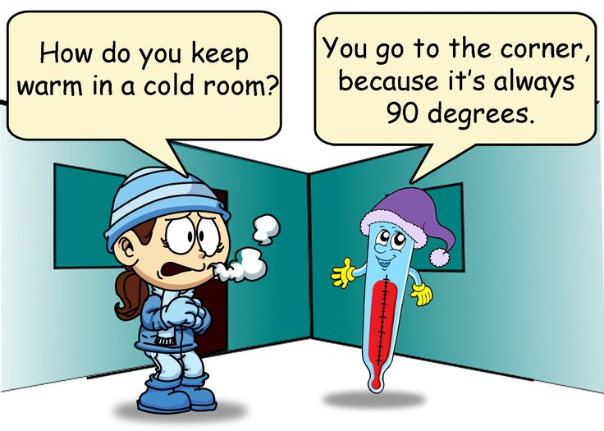
Do we recognize the constant we use? Do we know how it is obtained, introduced and measured? Can we get its value in an easy way?

Slide 9
What I expected teachers to do with introducing π
Student
Teacher
Measure the perimeter of the jar cap (round the cap) with fiber
Measure the diameter with ruler
Divide the obtained perimeter and diameter, for several different caps
Conclude
Provide necessary accessories – fiber, rulers, jar caps with different diameters
Give directions
Lead to the result

Slide 10
Using formulas
After obtaining the approximating value, introduce the constant π through formulas,
L is the circle perimeter,
d is he circle diameter,
r is the radius .
Therefore

Slide 11
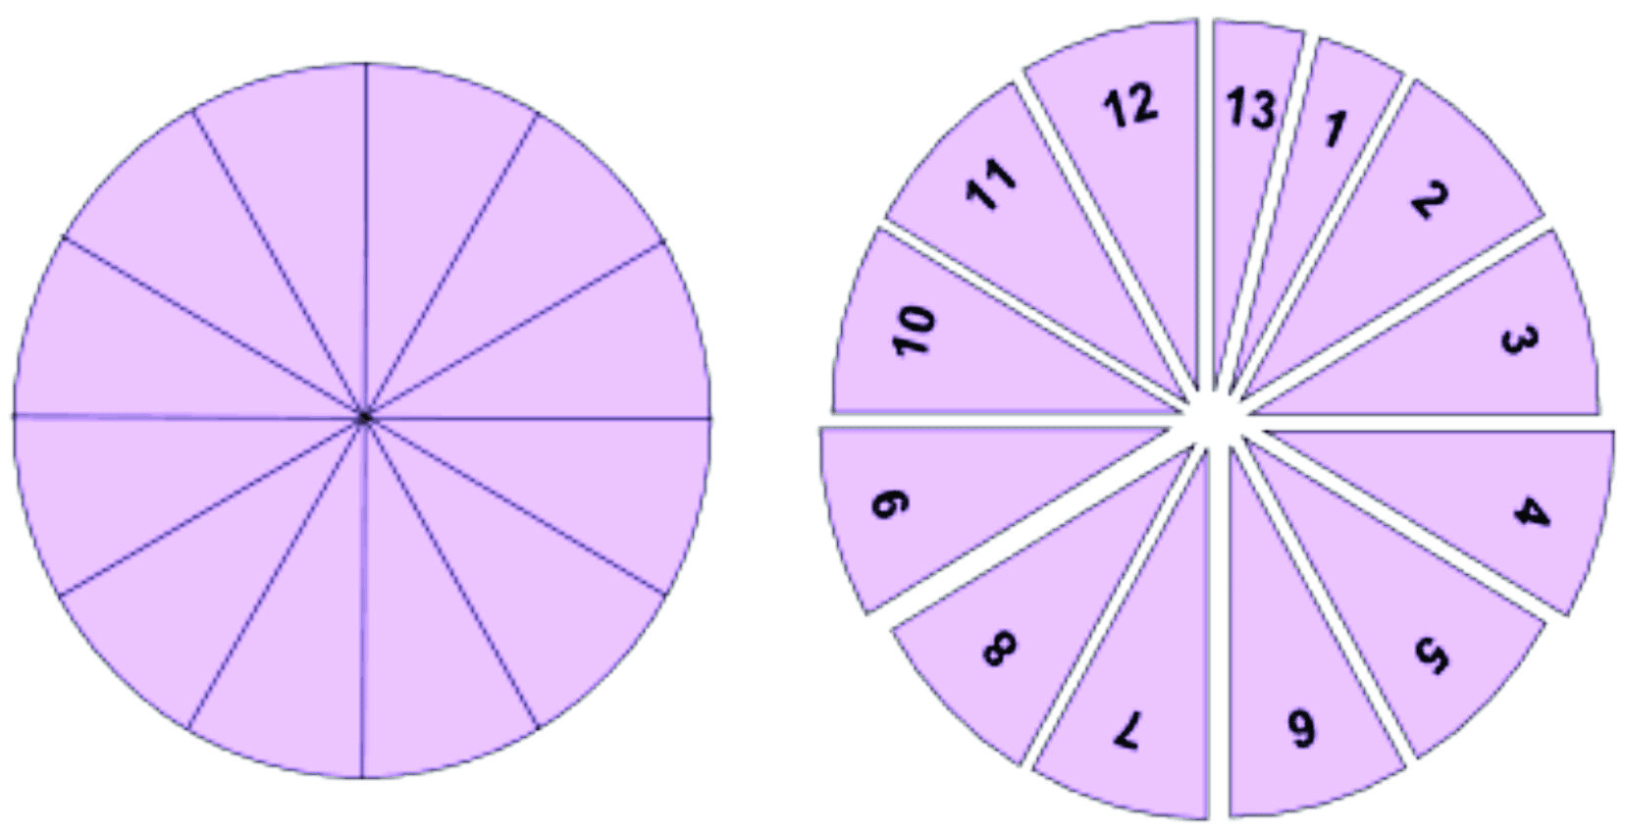
Another example of calculating the value of π

Slide 12
Pro and contra (short survey after several months)
Advantages obtained
Better adopting of knowledge
Better understanding the given problems
Better application
Appearance of critical thinking
Durability of knowledge
LEARNING WITH UNDERSTANDING
Disadvantages
More time is needed
More resources needed (materials, trainings)
More people (teachers) needed
Less material covered (paradox)

Slide 13
Macedonian case through one example
Two similar geometry problems with different objectives, in the same class, 9th grade, according to old and to new syllabus
Old style – Geometric 3D figures
Assignment :
Calculate the volume on the regular triangular prism with a given edge of the base of 6 cm and height of the prism of 8 cm.

Slide 14
Teachers observations on the objectives
The text directly reveals the kind of prism in question
Students should recognize the regular from the irregular bases
It is probably better let the students derive the conclusion of regularity with a differently given conditions
Making the sketch develops creativity and precision
Next step is to apply the given formula and interchange the values
The basic deficiency of the assignment is the fact that the student is included into passive thinking process
Research, individual work, functional thinking and concluding is neglected.

Slide 15
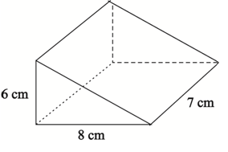
Macedonian case through one example
New style – Geometry and solving problems and Measuring and solving problems
Assignment :
Calculate the area of the prism shown on the picture below.

Slide 16
Teachers observations on the objectives
With only the picture given the students should determine the type of prism by them selves
They should make difference between types of edges, determine the height and use the given dimensions on the right place in the formula
The student has to be thinking functionally, developing the possibility of individual work
The walls of the prism should be distinguished by form
The logical thinking is present
The student should take active part in solving the problem and derive conclusions

Slide 17
The idea of comparison was for teachers to be able to use the good sides of both programs, to knit the suggested methods and obtain better results, higher level of knowledge adoption, better assessment results, better application of knowledge
BUT
there are the controlling mechanisms
inspections
almost no freedom in constructing the process
low self esteem
lack of dedication

Slide 18
Questions
The role of the teacher in the research approach
against the role of the textbook
The role of the classroom (equipment)
The role of the parents (projects)
The role of the teacher in the complete process of education and upbringing the students

Slide 19
Благодаря за вниманието!

